Slide 1



Business 360 Power BI Report_Sumana Ghosh
View in Power BI
Last data refresh:
12/25/2022 3:05:26 PM UTC
Downloaded at:
12/25/2022 3:28:51 PM UTC

Slide 2
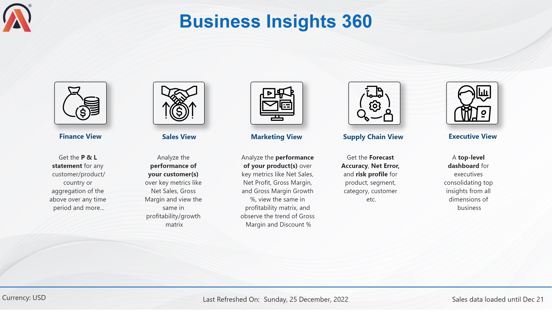
Home
Notes:
image
No alt text provided
image
No alt text provided
image
No alt text provided
image
No alt text provided
image
No alt text provided
image
No alt text provided
textbox
No alt text provided
textbox
No alt text provided
textbox
No alt text provided
textbox
No alt text provided
textbox
No alt text provided
textbox
No alt text provided
textbox
No alt text provided
textbox
No alt text provided
textbox
No alt text provided
textbox
No alt text provided
textbox
No alt text provided
Last Refreshed on
No alt text provided
shape
No alt text provided
card
No alt text provided
textbox
No alt text provided
card
No alt text provided

Slide 3
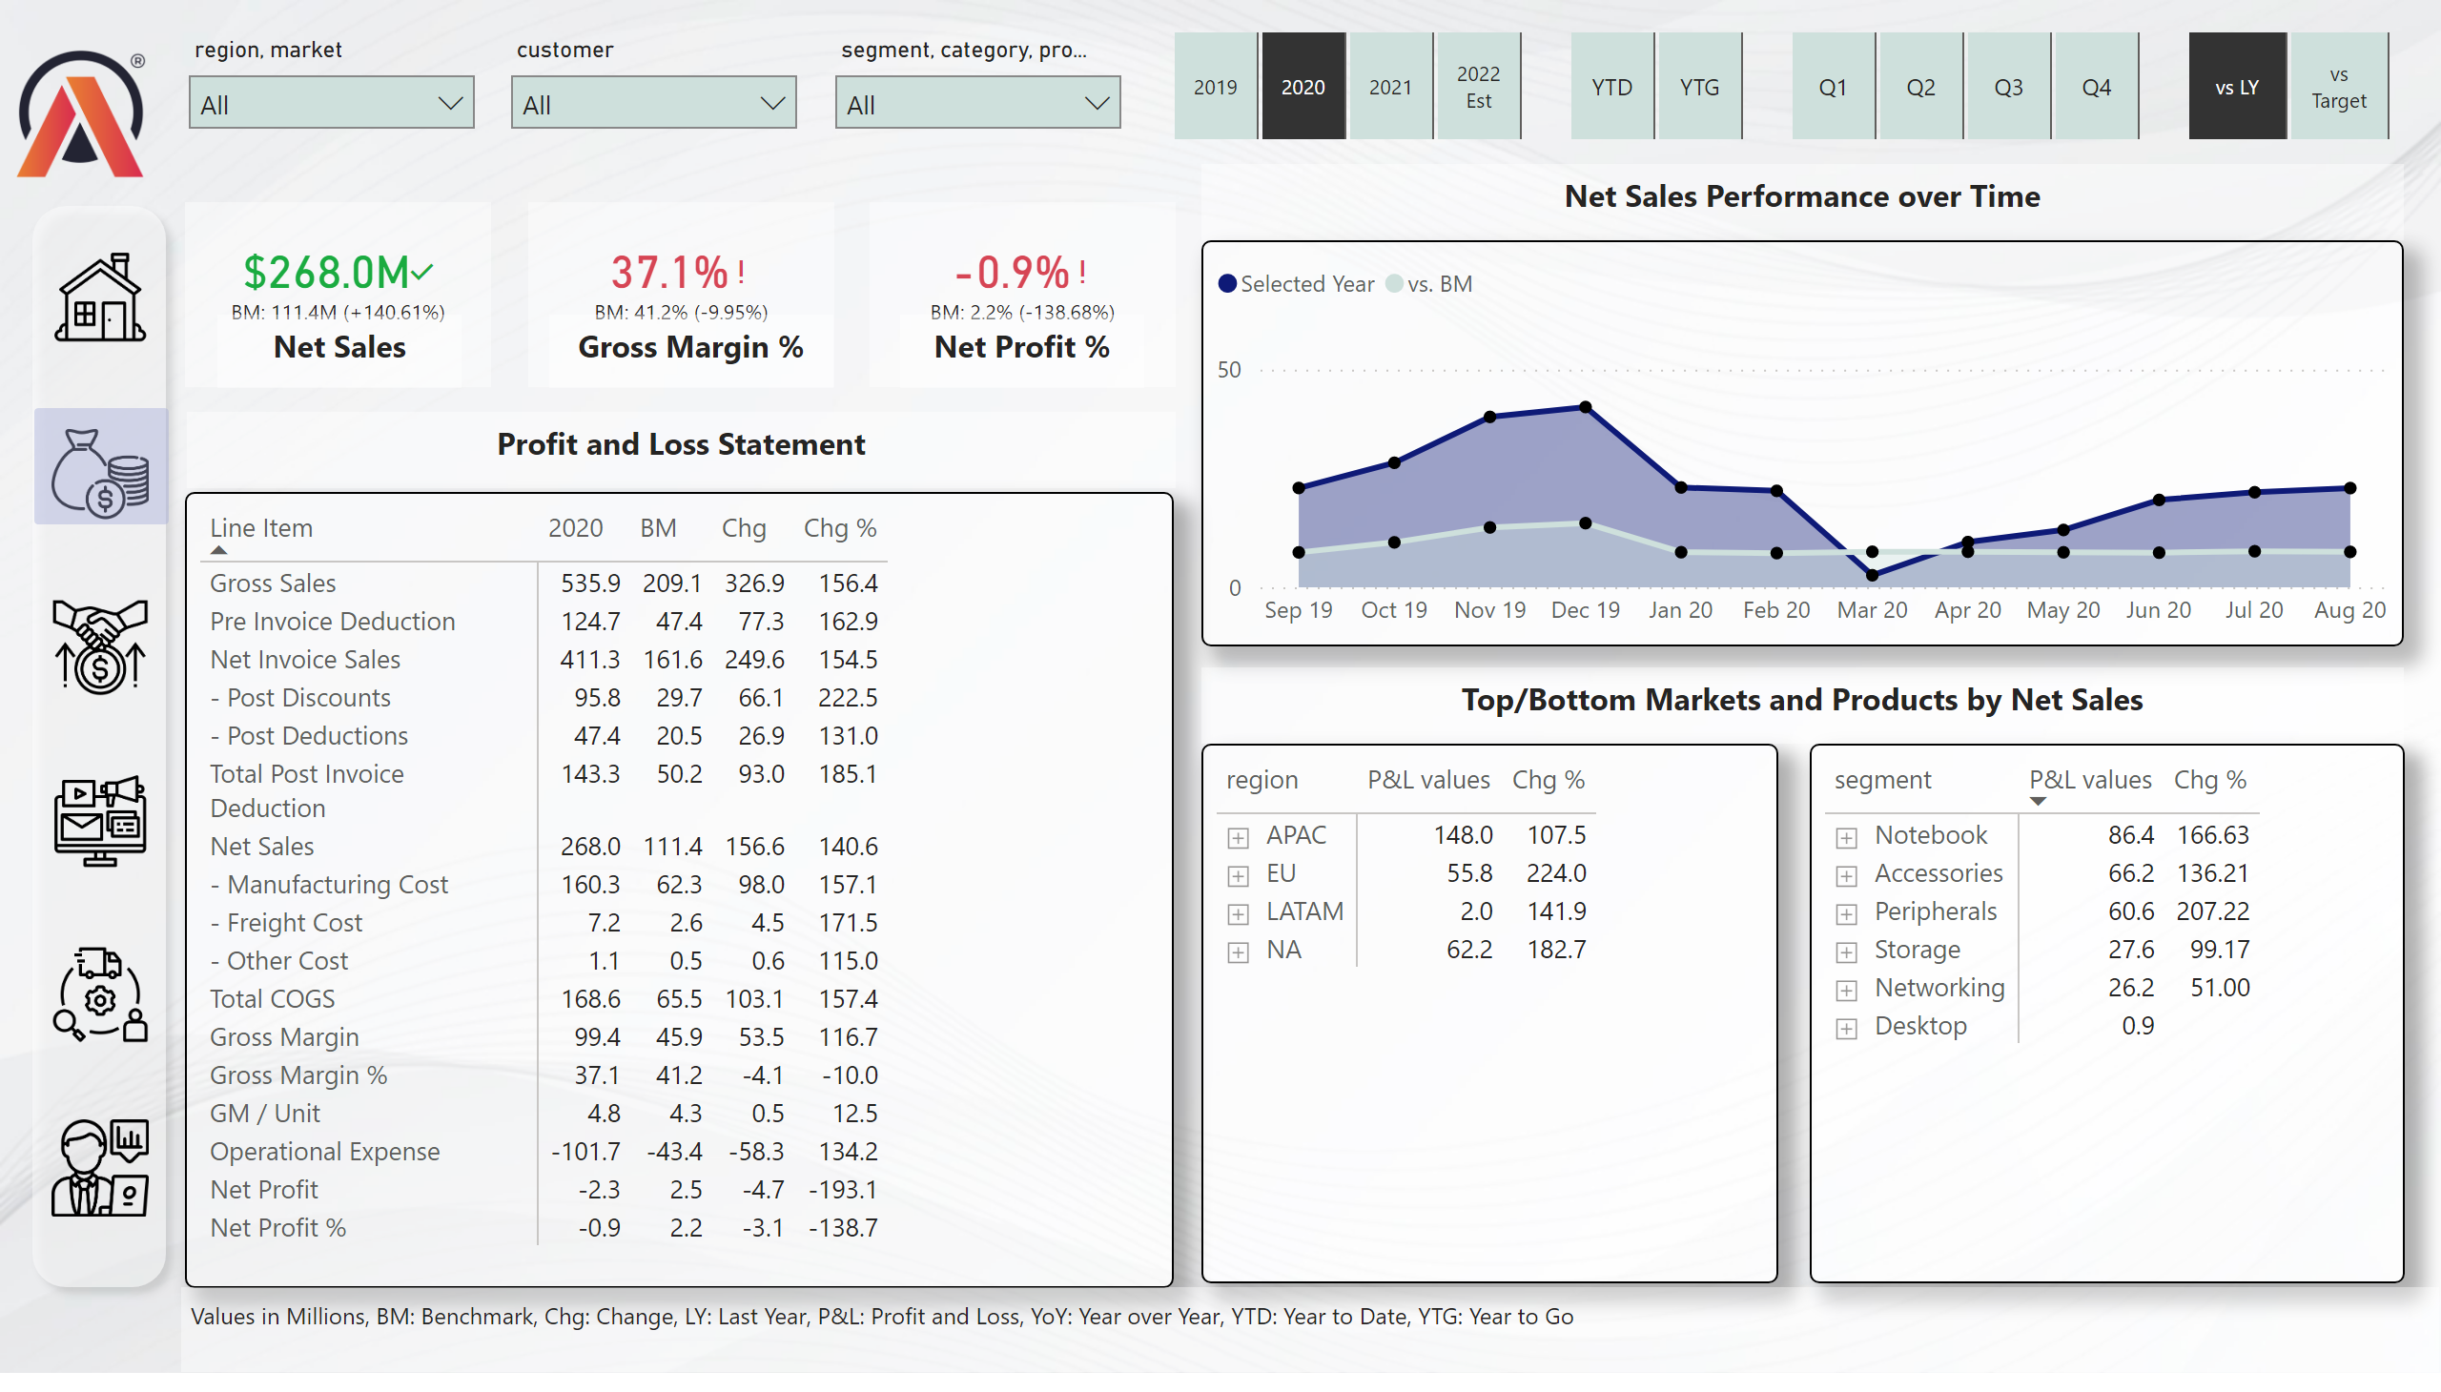
Finance View
Notes:
slicer
No alt text provided
pivotTable
No alt text provided
slicer
No alt text provided
slicer
No alt text provided
Net Sales Performance Over Time
No alt text provided
pivotTable
No alt text provided
pivotTable
No alt text provided
image
No alt text provided
textbox
No alt text provided
slicer
No alt text provided
slicer
No alt text provided
slicer
No alt text provided
kpi
No alt text provided
textbox
No alt text provided
kpi
No alt text provided
textbox
No alt text provided
kpi
No alt text provided
textbox
No alt text provided
shape
No alt text provided
image
No alt text provided
image
No alt text provided
image
No alt text provided
image
No alt text provided
image
No alt text provided
image
No alt text provided
shape
No alt text provided
textbox
No alt text provided
textbox
No alt text provided
textbox
No alt text provided
slicer
No alt text provided
card
No alt text provided

Slide 4
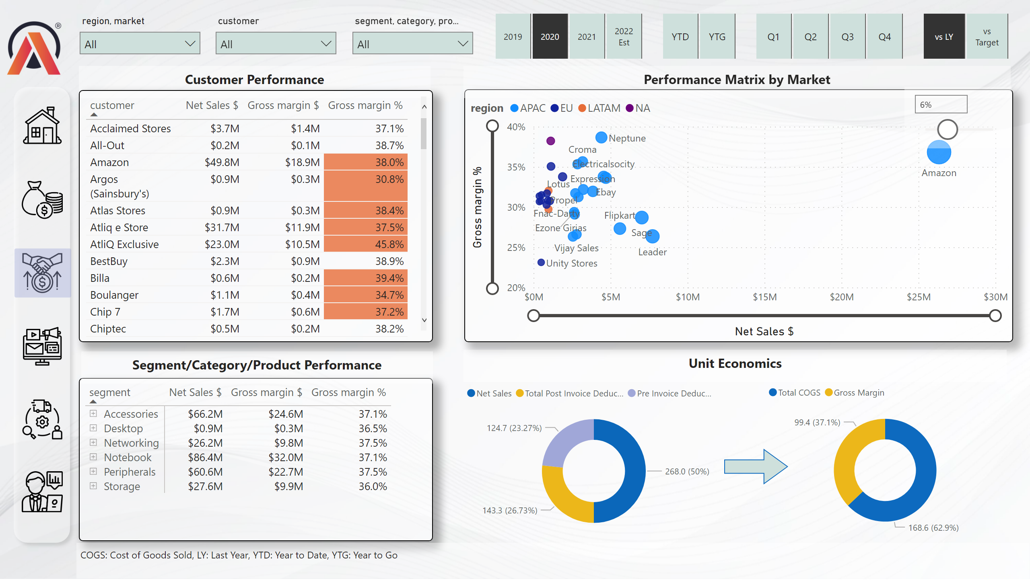
Sales View
Notes:
image
No alt text provided
textbox
No alt text provided
shape
No alt text provided
image
No alt text provided
image
No alt text provided
image
No alt text provided
image
No alt text provided
image
No alt text provided
image
No alt text provided
shape
No alt text provided
tableEx
No alt text provided
pivotTable
No alt text provided
scatterChart
No alt text provided
textbox
No alt text provided
donutChart
No alt text provided
shape
No alt text provided
donutChart
No alt text provided
textbox
No alt text provided
textbox
No alt text provided
slicer
No alt text provided
slicer
No alt text provided
slicer
No alt text provided
slicer
No alt text provided
slicer
No alt text provided
slicer
No alt text provided
slicer
No alt text provided
slicer
No alt text provided
textbox
No alt text provided

Slide 5
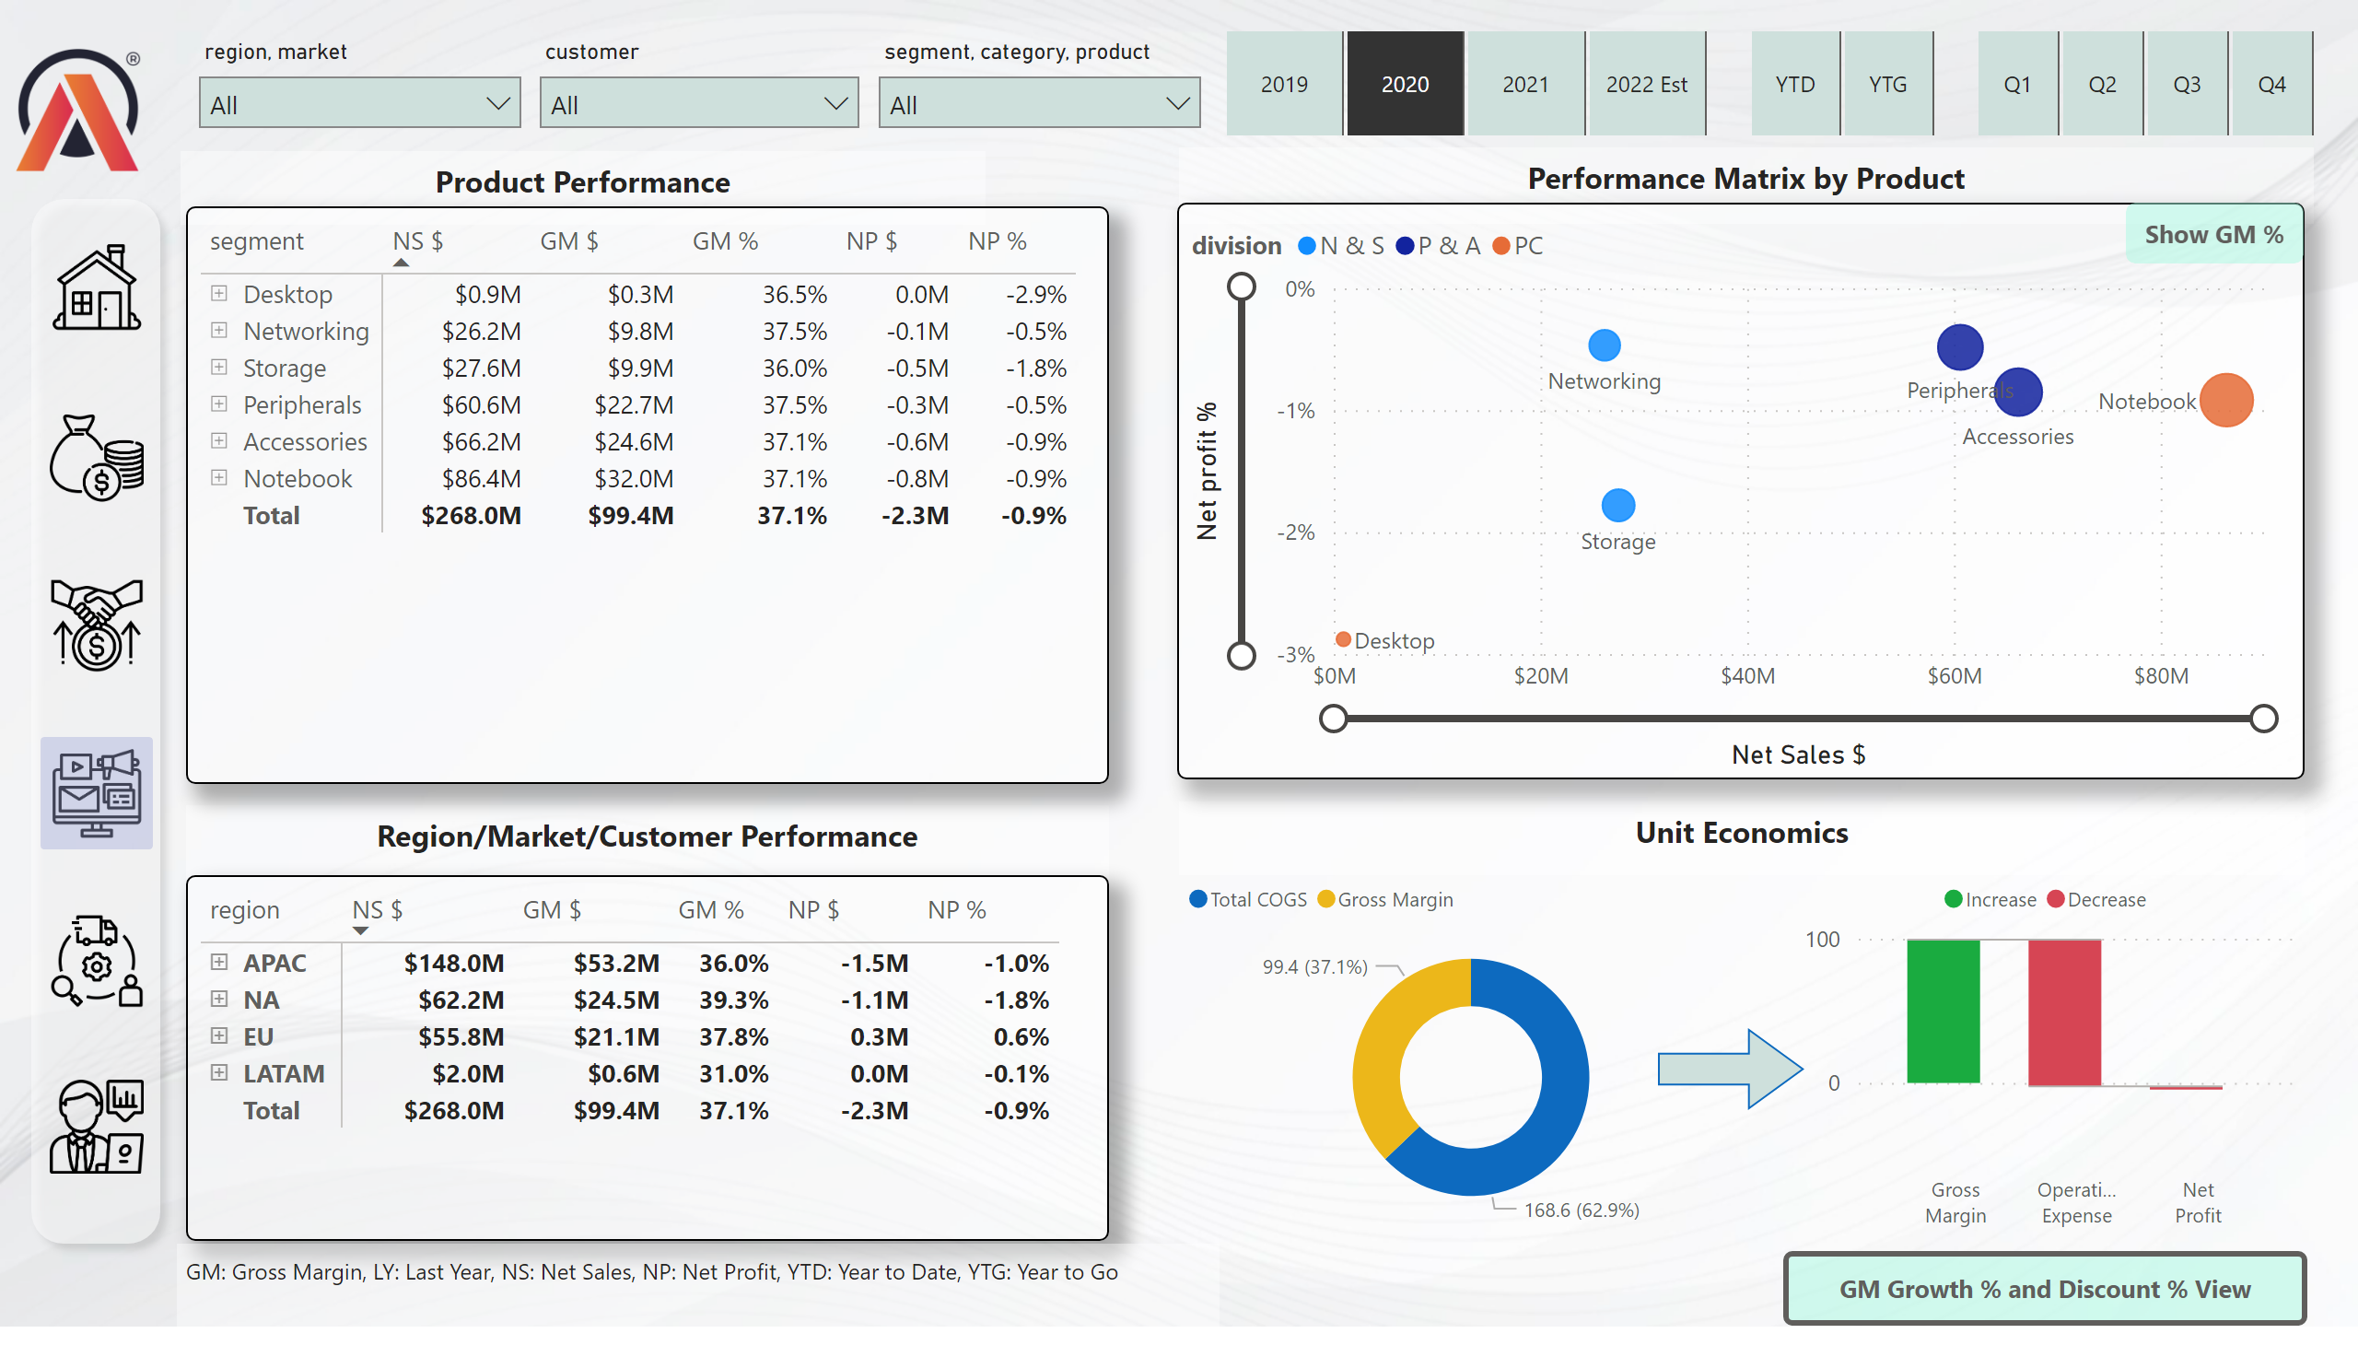
Marketing View 1
Notes:
slicer
No alt text provided
slicer
No alt text provided
slicer
No alt text provided
image
No alt text provided
textbox
No alt text provided
slicer
No alt text provided
slicer
No alt text provided
slicer
No alt text provided
shape
No alt text provided
image
No alt text provided
image
No alt text provided
image
No alt text provided
image
No alt text provided
image
No alt text provided
image
No alt text provided
shape
No alt text provided
textbox
No alt text provided
textbox
No alt text provided
textbox
No alt text provided
pivotTable
No alt text provided
pivotTable
No alt text provided
donutChart
No alt text provided
waterfallChart
No alt text provided
actionButton
No alt text provided
scatterChart
No alt text provided
Show GM %
No alt text provided
NP% Visual
No alt text provided
textbox
No alt text provided
actionButton
No alt text provided
shape
No alt text provided

Slide 6
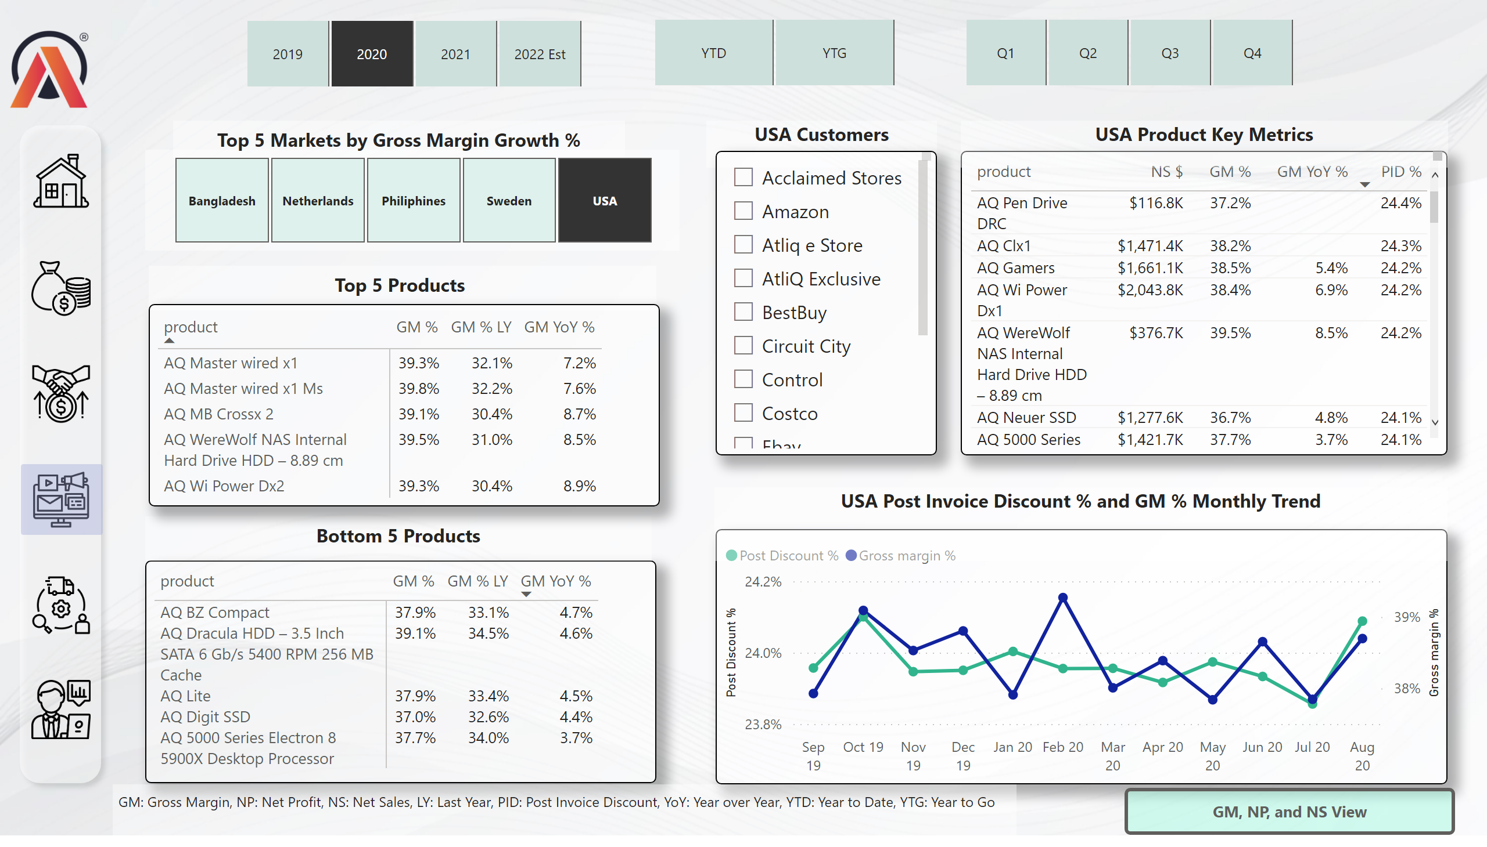
Marketing View 2
Notes:
image
No alt text provided
shape
No alt text provided
image
No alt text provided
image
No alt text provided
image
No alt text provided
image
No alt text provided
image
No alt text provided
image
No alt text provided
shape
No alt text provided
pivotTable
No alt text provided
USA Customers
No alt text provided
textbox
No alt text provided
textbox
No alt text provided
slicer
No alt text provided
textbox
No alt text provided
textbox
No alt text provided
pivotTable
No alt text provided
slicer
No alt text provided
slicer
No alt text provided
slicer
No alt text provided
slicer
No alt text provided
tableEx
No alt text provided
lineChart
No alt text provided
USA Product Key Metrics
No alt text provided
USA Post Invoice Discount % and GM % Monthly Trend
No alt text provided
actionButton
No alt text provided

Slide 7
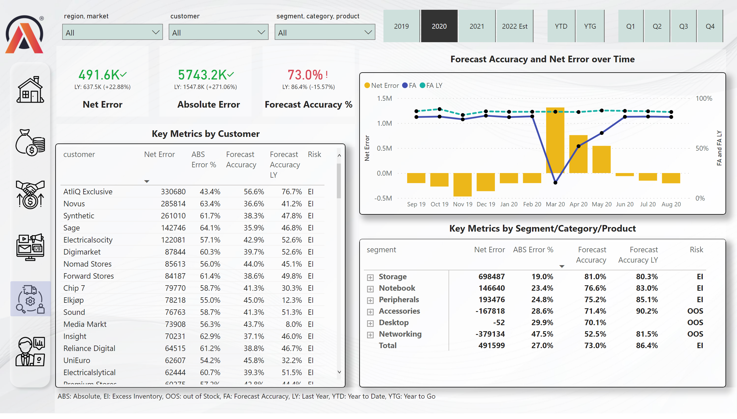
Supply Chain View
Notes:
slicer
No alt text provided
slicer
No alt text provided
slicer
No alt text provided
image
No alt text provided
textbox
No alt text provided
slicer
No alt text provided
slicer
No alt text provided
slicer
No alt text provided
kpi
No alt text provided
textbox
No alt text provided
kpi
No alt text provided
textbox
No alt text provided
kpi
No alt text provided
textbox
No alt text provided
shape
No alt text provided
image
No alt text provided
image
No alt text provided
image
No alt text provided
image
No alt text provided
image
No alt text provided
image
No alt text provided
shape
No alt text provided
pivotTable
No alt text provided
tableEx
No alt text provided
textbox
No alt text provided
lineClusteredColumnComboChart
No alt text provided
textbox
No alt text provided
textbox
No alt text provided

Slide 8
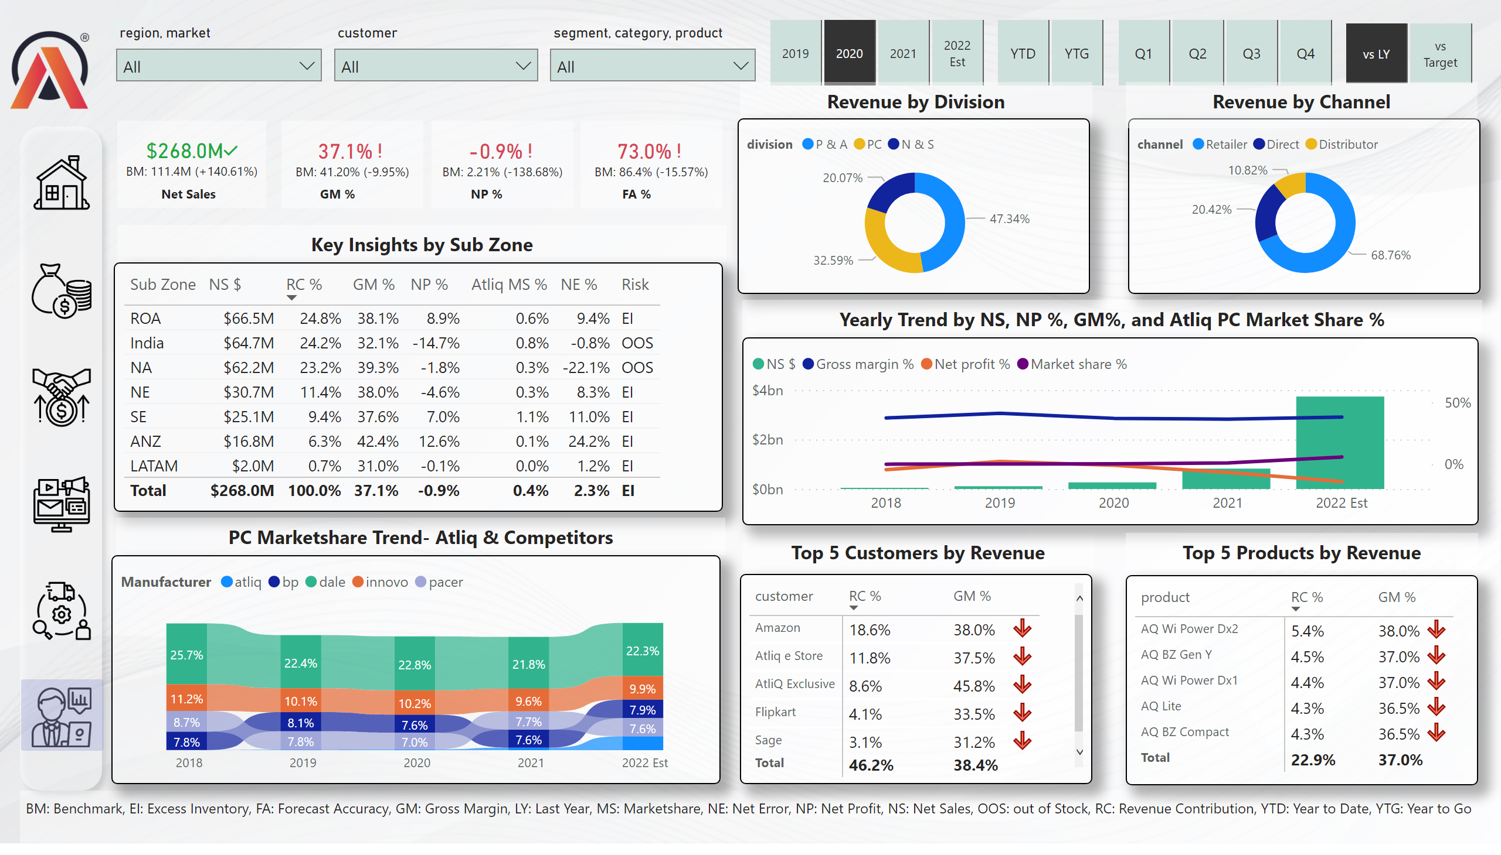
Executive View
Notes:
slicer
No alt text provided
slicer
No alt text provided
slicer
No alt text provided
image
No alt text provided
textbox
No alt text provided
slicer
No alt text provided
slicer
No alt text provided
slicer
No alt text provided
kpi
No alt text provided
textbox
No alt text provided
kpi
No alt text provided
textbox
No alt text provided
kpi
No alt text provided
textbox
No alt text provided
shape
No alt text provided
image
No alt text provided
image
No alt text provided
image
No alt text provided
image
No alt text provided
image
No alt text provided
image
No alt text provided
shape
No alt text provided
textbox
No alt text provided
textbox
No alt text provided
textbox
No alt text provided
slicer
No alt text provided
card
No alt text provided
kpi
No alt text provided
textbox
No alt text provided
tableEx
No alt text provided
ribbonChart
No alt text provided
textbox
No alt text provided
donutChart
No alt text provided
donutChart
No alt text provided
textbox
No alt text provided
textbox
No alt text provided
lineClusteredColumnComboChart
No alt text provided
pivotTable
No alt text provided
pivotTable
No alt text provided
textbox
No alt text provided

Slide 9
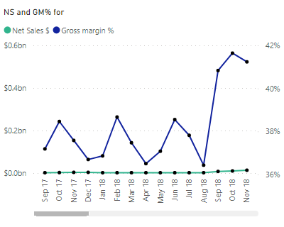
Sales and GM trend
Notes:
NS and GM% for
No alt text provided

Slide 10
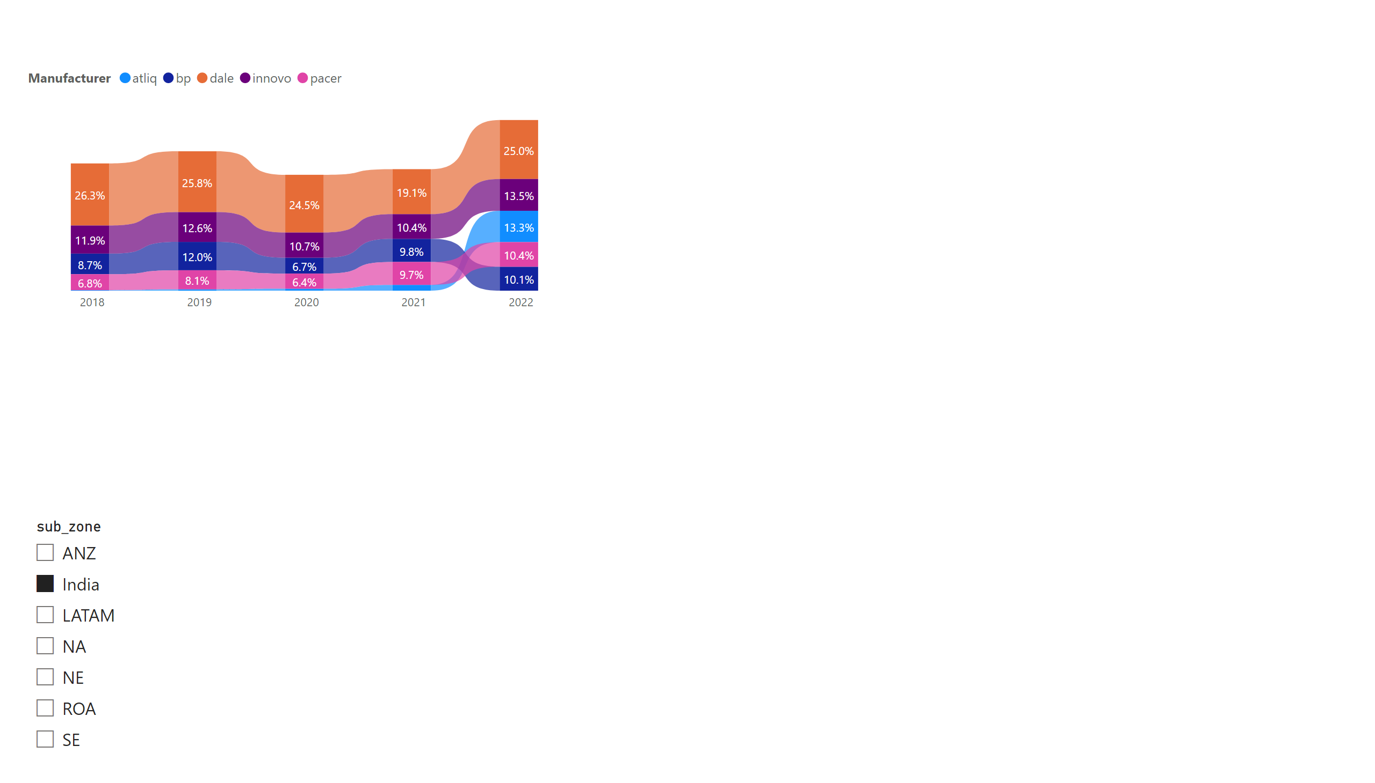
Market Share
Notes:
ribbonChart
No alt text provided
slicer
No alt text provided

